Slide 1

WELCOME
TO
LUNCH
AND
LEARN
We’re going to provide you with some food to eat and some food for thought

Slide 2







Slide 3
E
mpathy
HOW DO WE MAKE OUR COMMUNITY INCLUSIVE FOR PEOPLE WITH AUTISM?
E
ducation/
xperiences
E
xplore

Slide 4



E
mpathy
Empathy is a respectful understanding of what others are experiencing.
- Marshall B. Rosenberg
Empathy is the starting point for creating a community and taking action. It’s the impetus for creating change.
- Max Carver
Empathy is seeing with the eyes of another, listening with the ears of another, and feeling with the heart of another.

Slide 5

E
ducation/
xperiences
If you’ve met one person with autism, you’ve met one person with autism.
-Dr. Steven Shore

Slide 6
Our Department
E
ducation/
xperiences
Autism
Characteristics
Communication
Needs
Learning
Difficulties
Restricted
Interests
Limited
Self Help Skills
Sensory
Regulation
Processing Diffuculties
Behavioral Issues

Slide 7


E
Locations
  Dental
  Emergency Services
  Entertainment
  Hospitality
  Medical
  Parks and Recreation
  Public Service
  Religion
  Retail
xplore
Is______________ an inclusive place for people with autism?

Slide 8
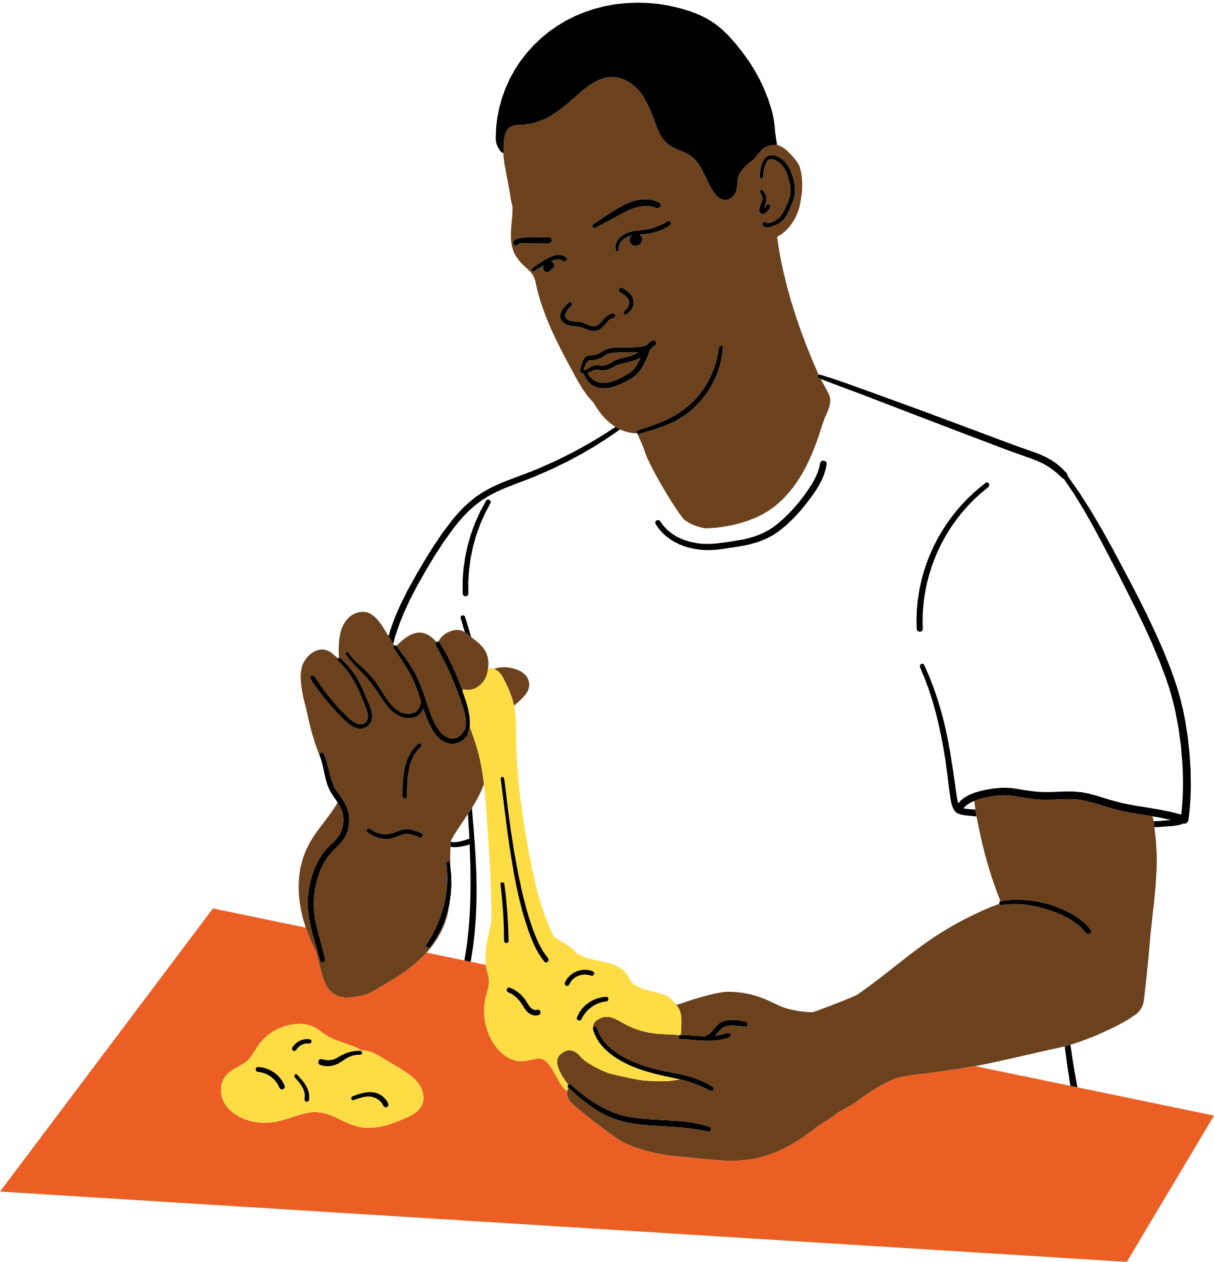





Sensory Items

Slide 9



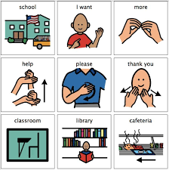
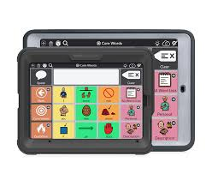
Communication Items

Slide 10
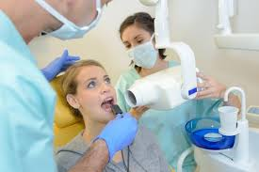
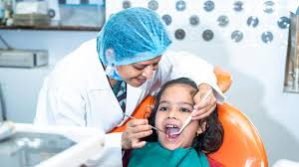
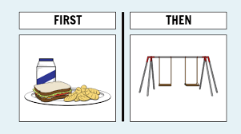

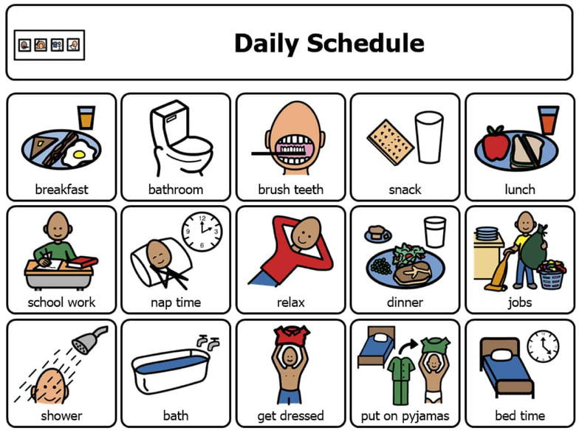
Structure/
Predictability

Slide 11


Slide 13
CAREGIVER AWARENESS
How can you help to alleviate the work of caregivers for people with autism?
Resource Directory
List of places and their resources
Social Media
Share you inclusivity measures on social media page
Word Of Mouth
Caregivers will share with other caregivers!
Support Agencies
Share your info and in turn you will receive more advertisement from the autism community
Fundraising/Events
Support local agencies or celebrate autism awareness month

